Slide 1
OS

Slide 2


Slide 3
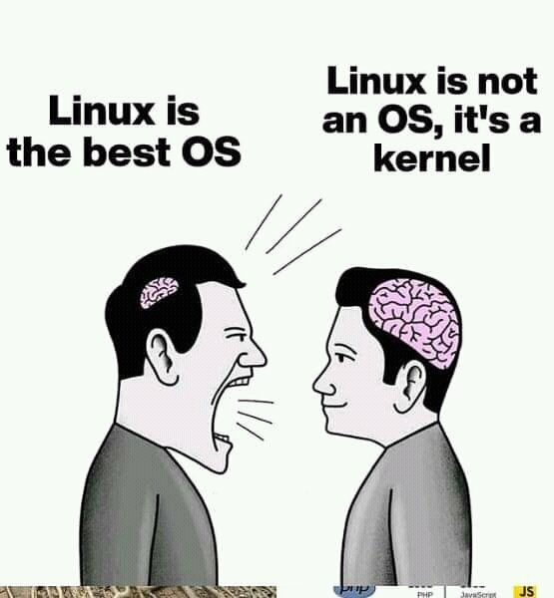

Slide 4




Top 500 Super Computers Servers 95%
86% MOBILES ALL ELECTRONIC GADGETS

Slide 5
Where is linux ..?
Space Station
Defence
Satellite
NY Stock Exchange
Gaming Industry
Amazon Kindle
TVS
Cars
Smartphones
Gedgets

Slide 6
Why to use linux ..?
Free and Open-Source
Security will be high
High Performance
Multi User Based
It Supports all Programming Languages
High Speed

Slide 7
Differences ..?
KERNEL: Managing Low-Level tasks Hardware & Resources
OS: Manages User Interface & Application

Slide 8

UBUNTU
REDHAT
CENTOS

Slide 9

Flavours/Distributions ..?
Iphone15 → 15+ → 15 pro → Pro max
UBUNTU 70%
REDHAT
CENTOS
FEDORA
DEBIAN
ROCKY LINUX
KALI LINUX

Slide 10
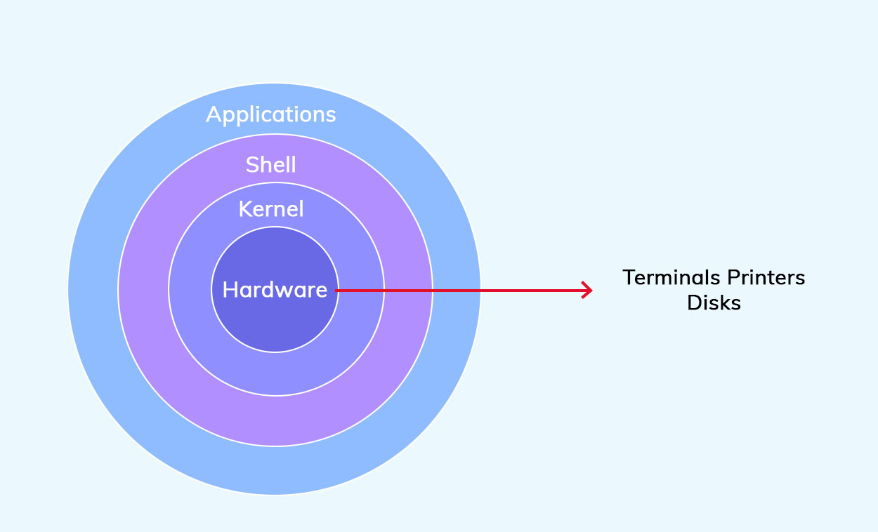
SHELL:
DEALS WITH I&O
DAEMON:
DEALS WITH BACKGROUND PROCESS
KERNEL:
DEALS WITH HARDWARE
(CPU,RAM,ROM)

Slide 11
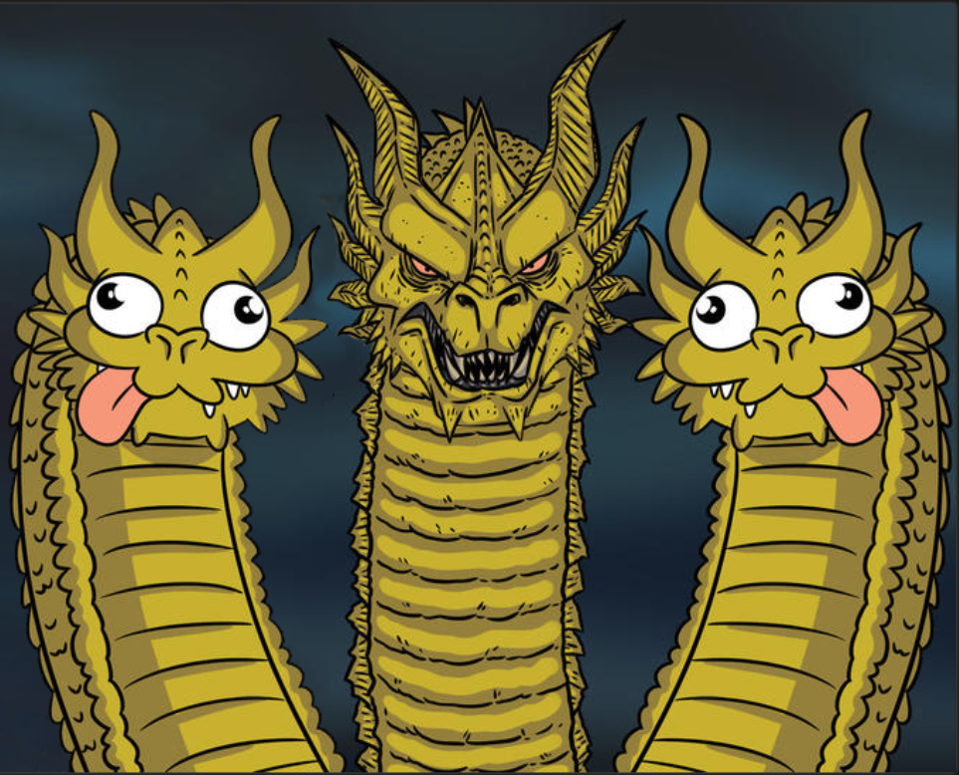
REAL TIME OS LEADER FOR SERVER
MAC-OS LINUX WINDOWS

Slide 12
Linux vs Windows (Simple Table)
| Feature | Linux | Windows
| ------------ | ---------------------------- | --------------
| Cost | Free | Paid
| Source Code | Open | Closed
| Viruses | Very rare | Common
| Customizable | Yes | Limited
| Used for | Servers, DevOps, Programming | Office, Gaming |

Slide 13
📂 Linux Directory Structure (File System)
Linux organizes files like a tree:
/
/home → User files
/bin → Basic commands
/etc → Config files
/var → Logs
/tmp → Temporary files
/root → Admin user’s home

Slide 14
1: Navigation Commands (Moving Around)
Command | Purpose | Real-Life Example
pwd | Print Working Directory | "Where am I?"
ls | List files | "What's in this folder?"
cd folder_name | Change Directory | "Go into this room"
cd .. Ls –a Ll | Go back one folder To list hidden files To long list files | "Step out of the room”
Echo “hello”
Head –n5 filename
tail filename
Wc
Cut –b 1 filename
Cut –b 1-4 filename
Tee
Diff filename1 filename2
Df
Vmstat

Slide 15
2: BASIC COMMANDS:
Command | Purpose | Real-Life Example
touch file.txt | Create empty file | Create a new notebook
cat file.txt | Show file content | Read notebook
nano file.txt | Edit file (in terminal) | Write something in notebook
rm file.txt | Delete file | Tear up notebook
mkdir foldername | Make directory | Create new folder
rmdir foldername | Remove empty folder | Trash an empty box
rm -r foldername | Remove folder with stuff | Trash full box
3: Move, Copy, Rename Files
Command | Purpose | Real-Life Example
cp | Copy file | Photocopy a paper
mv | Move or rename file | Move file or rename notebook

Slide 16
4: Permissions
Command | Purpose | Real-Life Example
chmod | Change permissions | Lock/unlock file access
chown | Change file owner | Transfer file to another person
5: System Info & Processes
Command | Purpose
top | Show running tasks
ps | Show process status
df -h | Disk space usage
free -h | Memory usage
uptime | How long system is on
whoami | Show current user
uname -a | Linux version info

Slide 17
6: Package Management (Install/Remove Software)
Ubuntu/Debian (APT):
bash
sudo apt update # refresh list
sudo apt install tree # install package
sudo apt remove tree # uninstall
RedHat/CentOS (YUM):
bash
sudo yum install nano
7: Network Commands
Command | Purpose
ping google.com | Check internet connection
ifconfig / ip a | See IP address
netstat -tuln | Show open ports

Slide 18
8: Search & Help
Command | Purpose
find . -name "*.txt" | Find files
grep "word" file.txt | Search in file
man command | Manual/help
history | See past commands
PRACTICAL MINI PROJECT (DO IT YOURSELF):
Task: Make a “project” folder and organize files
mkdir project
cd project
touch todo.txt
echo "Learn Linux" > todo.txt
mkdir notes
cp todo.txt notes/
ls notes/
rm todo.txt
This teaches: mkdir, cd, touch, echo, cp, rm

Slide 19
Summary Cheat Sheet
Category | Sample Commands
Navigation | pwd, ls, cd
File | touch, cat, nano, rm, mkdir
Move/Copy | cp, mv
Permissions | chmod, chown
System Info | top, df, free, uptime
Network | ping, ip a
Help | man, --help, history, grep

Slide 20
Linux file permissions
🔰 Step 1: What Are File Permissions?
In Linux, permissions control who can read, write, or execute a file or folder.
There are 3 types of users and 3 types of permissions :
Users:
1. Owner – person who created the file
2. Group – team the file belongs to
3. Others – everyone else
Permissions:
| Symbol | Meaning |
| ------ | ------- |
| `r` | Read |
| `w` | Write |
| `x` | Execute |
---

Slide 21
📁 Step 2: Real-Life Analogy – Office Files
Imagine:
* You (Owner) create a document
* Your team (Group) should view it but not edit it
* Outsiders (Others) should not even open it
Permissions would look like:
```
r w - r - - - - -
Owner Group Others
```
---

Slide 22
🔍 Step 3: Check File Permissions
Use the `ls -l` command:
```bash
ls -l myfile.txt
```
Sample output:
```
-rw-r--r-- 1 jarves staff 0 Jul 6 15:00 myfile.txt
```
Breakdown:
| Part | Meaning |
| ------------ | ----------------------- |
| `-rw-r--r--` | File type + permissions |
| `jarves` | Owner |
| `staff` | Group |
| `myfile.txt` | File name |
So:
* Owner: `rw-` → read & write
* Group: `r--` → read-only
* Others: `r--` → read-only
---

Slide 23
Example 3: Full control for owner, none for others
```bash
chmod 700 secret.txt
```
Means:
* Owner: read, write, execute
* Group: none
* Others: none
---
🛠️ Step 4: Change Permissions with `chmod`
Format:
```bash
chmod [permissions] filename
```
Example 1: Make file executable for owner
```bash
chmod u+x myfile.sh
```
Means: Give execute (`x`) permission to **user/owner**.
Example 2: Remove read permission from others
```bash
chmod o-r myfile.txt
```
Now outsiders can’t view it.

Slide 24
🔢 Step 5: Shortcut with Numbers (Octal Notation)
| Permission | Binary | Octal |
| ---------- | ------ | ----- |
| rwx | 111 | 7 |
| rw- | 110 | 6 |
| r-- | 100 | 4 |
| --- | 000 | 0 |
So:
```bash
chmod 755 script.sh
```
Means:
* Owner: `7` → rwx
* Group: `5` → r-x
* Others: `5` → r-x
---

Slide 25
🧪 Step 6:(Practice)
```bash
touch testfile
chmod 644 testfile
ls -l testfile
```
Means:
* Owner: `rw-`
* Group: `r--`
* Others: `r--`
Now:
```bash
chmod u-x testfile # Remove execute from user (though it wasn’t there)
chmod g+w testfile # Add write to group
ls -l testfile
```
---

Slide 26
✅ Summary
| Symbol | Stands for |
| ------ | ------------ |
| `u` | user (owner) |
| `g` | group |
| `o` | others |
| `a` | all |
| Symbol | Action |
| ------ | ------ |
| `+` | add |
| `-` | remove |
| `=` | assign |
---
END
Virat v

